Slide 1
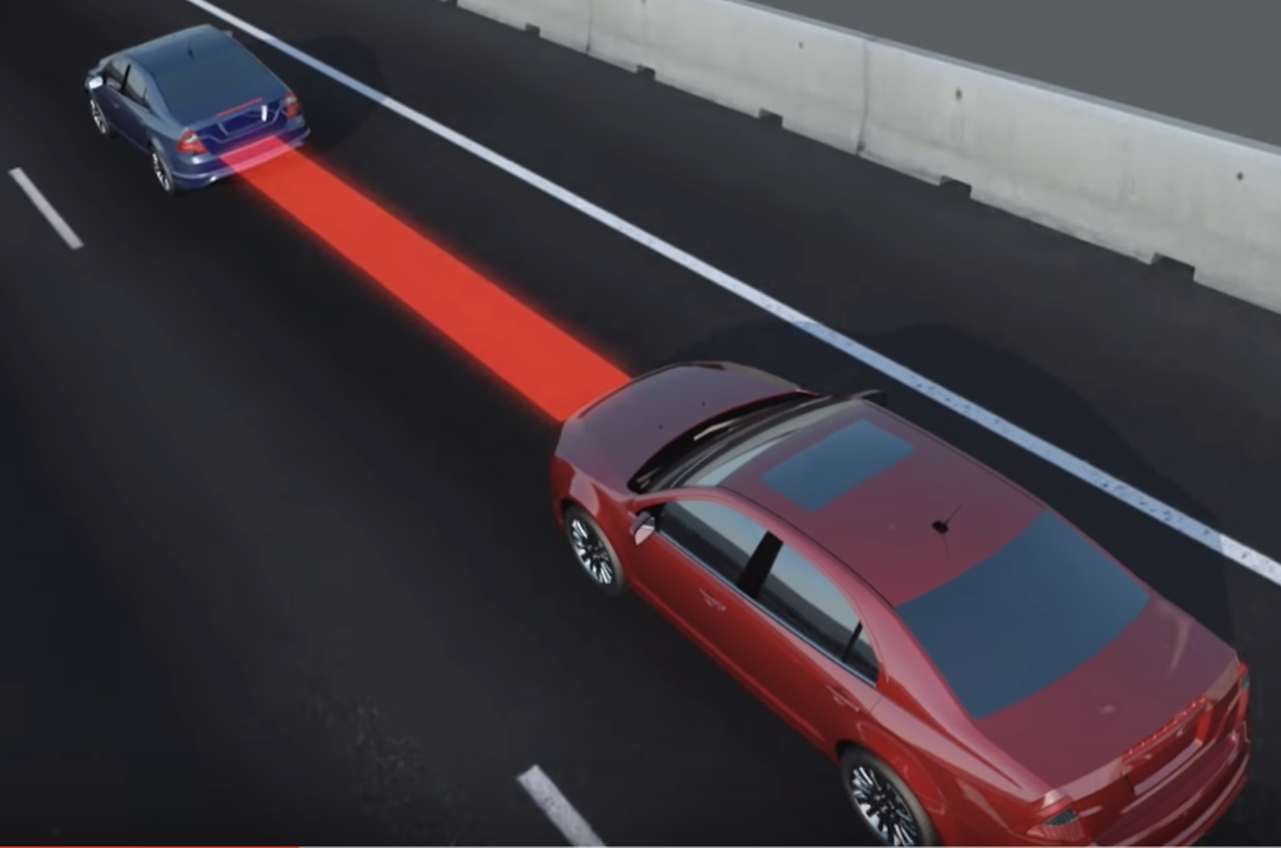
TicTacToe
TicTacToe with Robot Arm
Li Lin
Zhaofeng Tian
Group 8
Advisor: Prof. Pandya

Slide 2
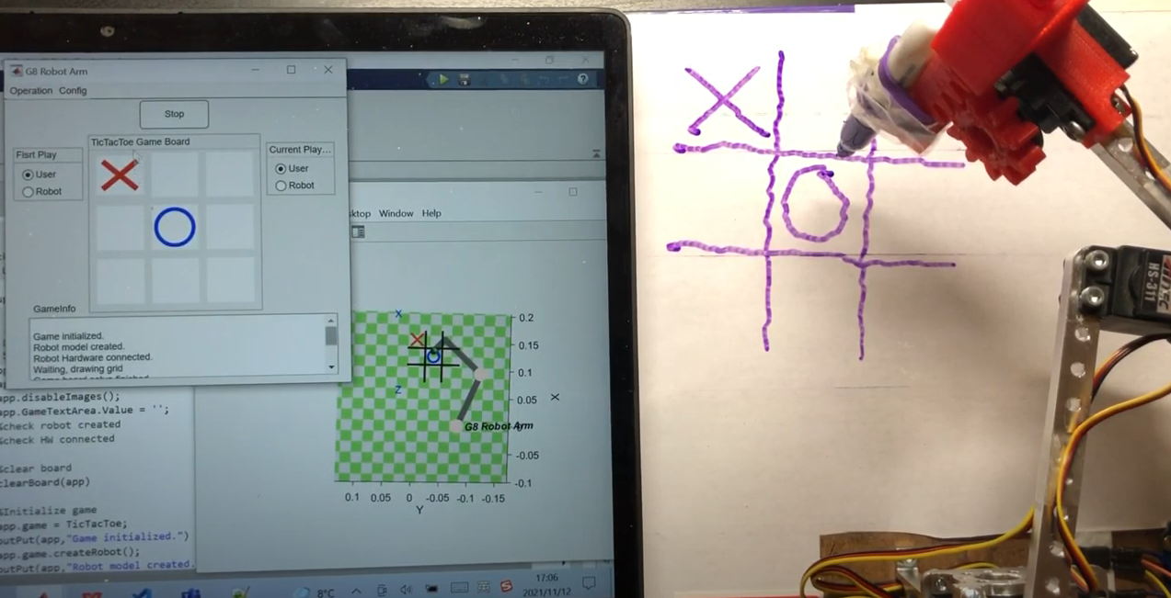
TicTacToe
1. Introduction
In this project, we design a Robot Arm that can play the TicTacToe game with human users and demonstrate the corresponding simulator in the Matlab GUI. Moreover, a game strategy designed can guarantee a win or tie for the robot.
Check the link to watch full demo:
video

Slide 3
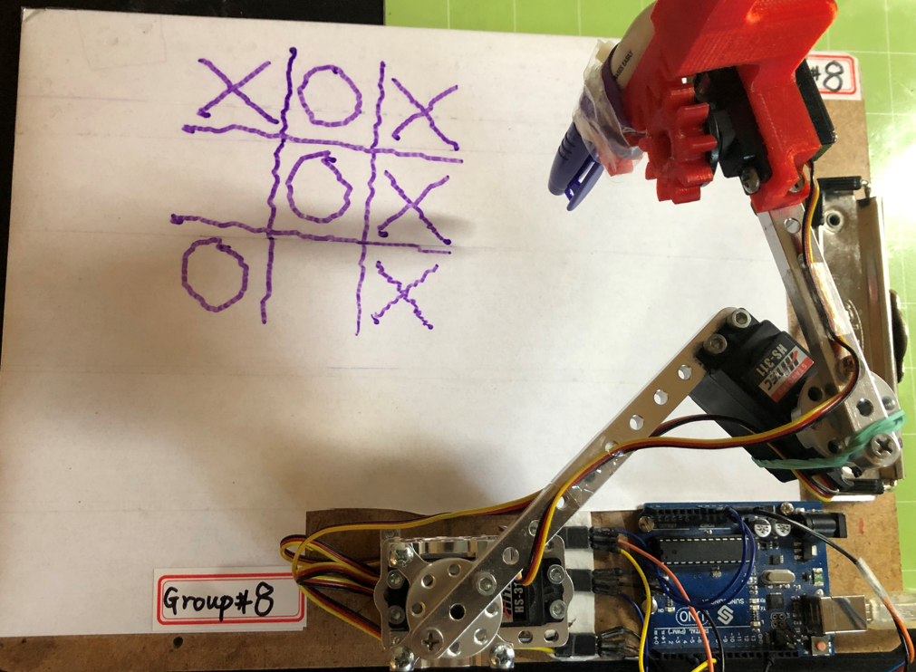
TicTacToe
2. Hardware

Slide 4
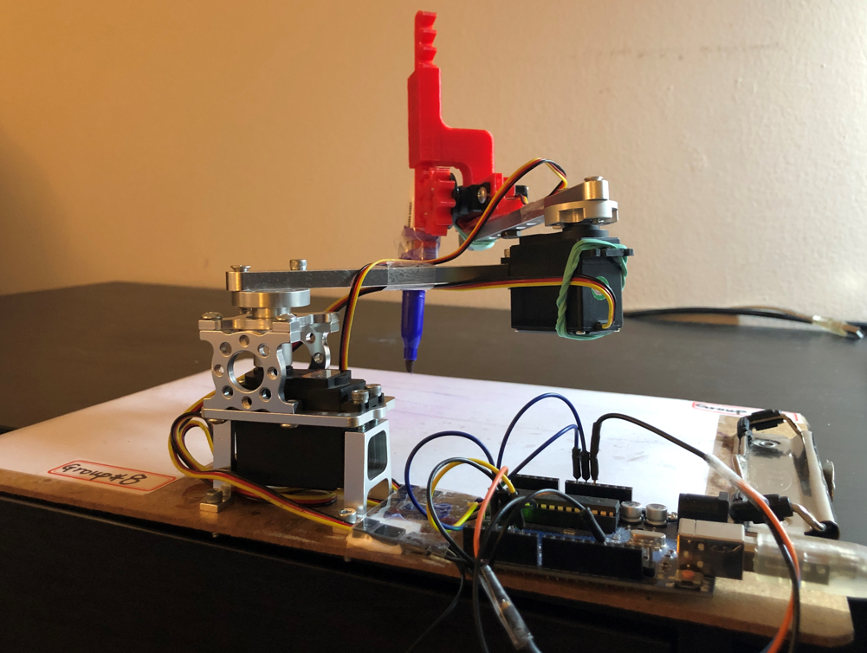
TicTacToe
2. Hardware improvement
Standard Hub Shaft ServoBlock

Slide 5
How to move EE
A
B
(X₀, Y₀, Z₀)
(X_{f}, Y_{f}, Z_{f})
%use fkine with initial q0 to get initial position
T0 = robot.fkine(q0);
%change the position para to final position para
T0.t(1) = X_{f};
T0.t(2) = Y_{f};
T0.t(3) = Z_{f};
%use ikine to get final position joint angles
q_{f} = robot.ikine(T₀, “q0”, q0, “mask”, [1 1 1 0 0 0]);
%use plot() with qf to move EE
robot.plot(qf)
Moving End-effector from one place to another is basic for this project

Slide 6
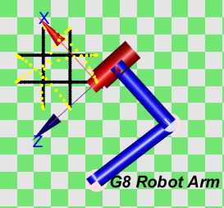
Move to EE smootly
[qx,qd,qdd]=mtraj(@tpoly, q0, qf, 8);
[Q,QD,QDD] = mtraj(TFUNC, Q0, QF, M) is a multi-axis trajectory (MxN) varying from state Q0 (1xN) to QF (1xN) according to the scalar trajectory function TFUNC in M steps.
[S,SD,SDD] = tpoly(S0, SF, M) is a scalar trajectory (Mx1) that varies
smoothly from S0 to SF in M steps using a quintic (5th order) polynomial.
The yellew dots are moving trajectory without drawing

Slide 7
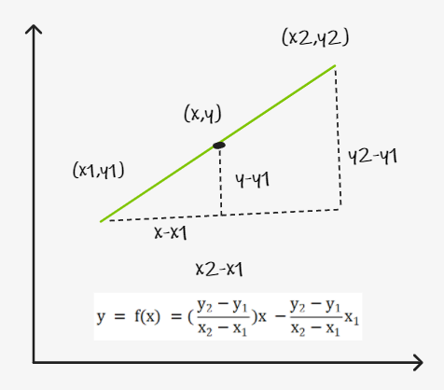
How to draw a line
To draw a straight line from one point to another
Have to interpolate the line
Vertical or Horizontal Line
x = linspace(x1, x2, 40)
y = linspace(y1, y2, 40)
points = [x;y]’
Not Vertical or Horizontal Line
x = linspace(x1, x2, 40)
y = f(x)
points = [x;y]’

Slide 8
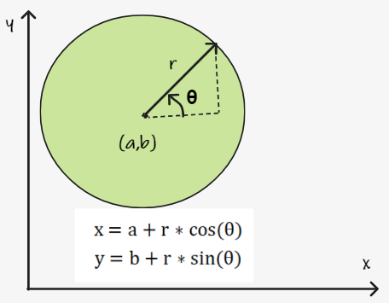
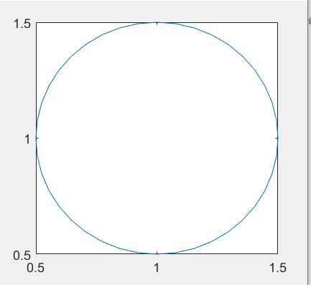
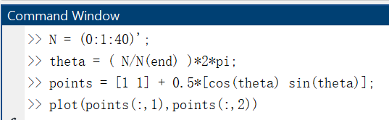
How to draw circle
N = (0:1:40)';
theta = ( N/N(end) )*2*pi;
points = ([a b] + r*[cos(theta) sin(theta)];

Slide 9
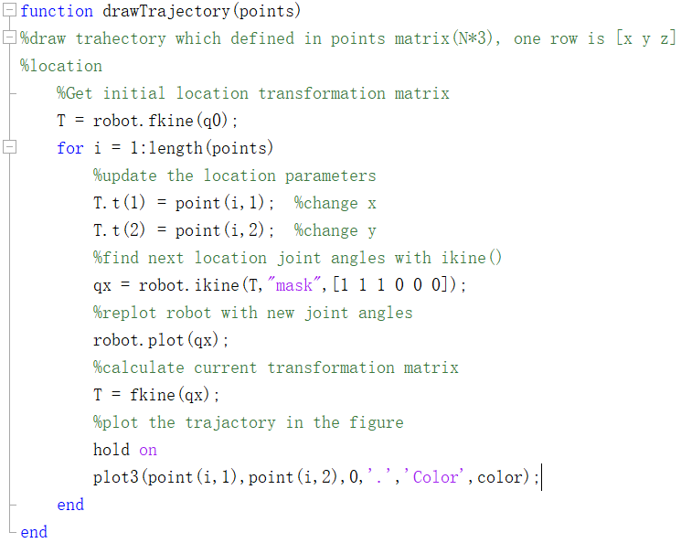
How to draw the trajectory
Basic logic to draw trajectory

Slide 10
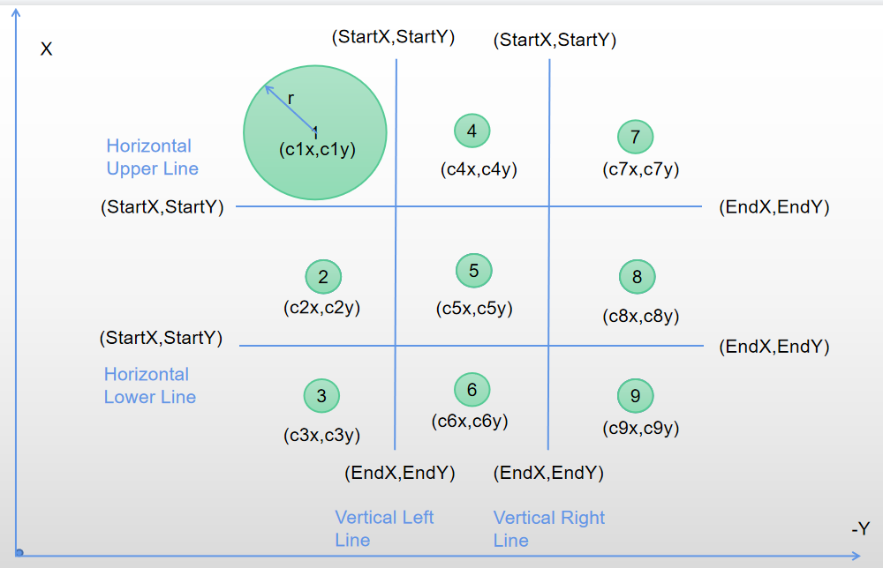
Define the game board

Slide 11
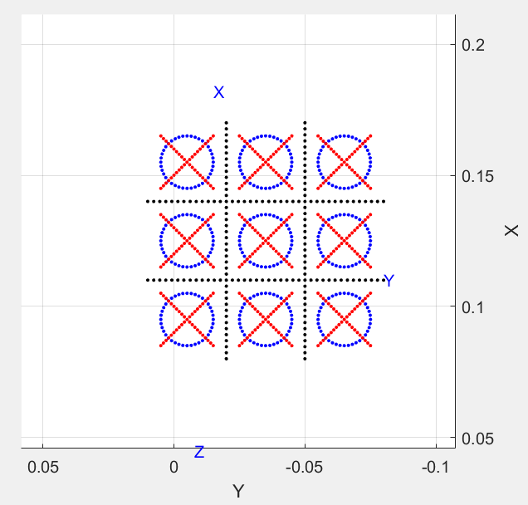
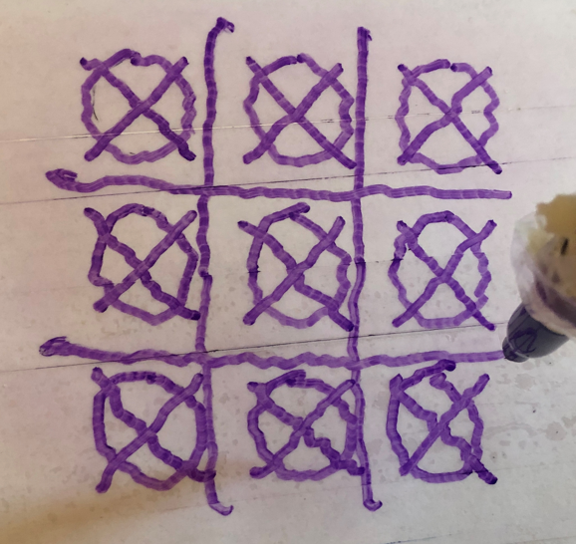
Actual drawing

Slide 12
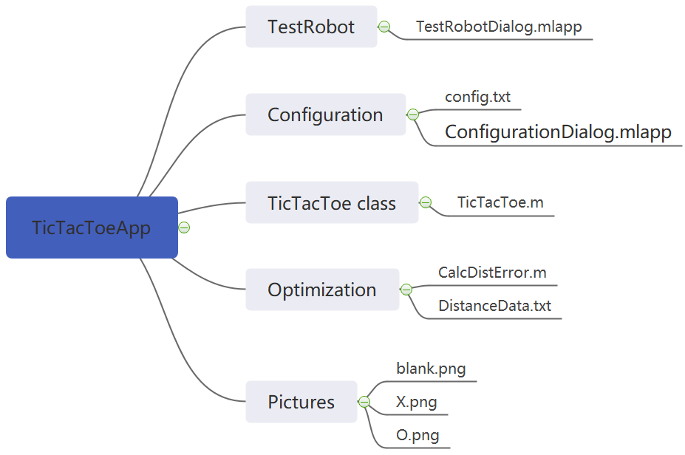
Project Structure

Slide 13
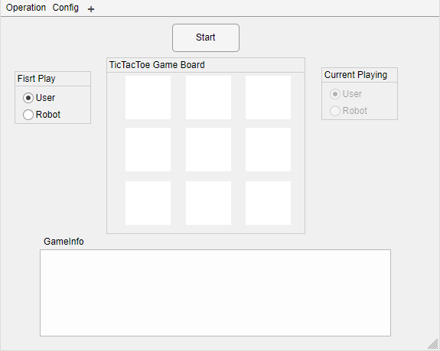
TicTacToe App

Slide 14
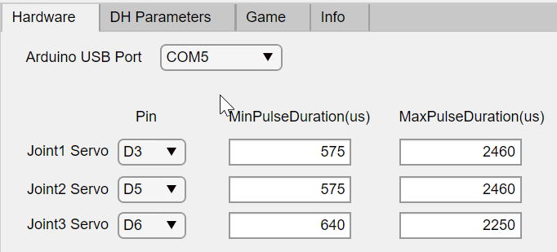
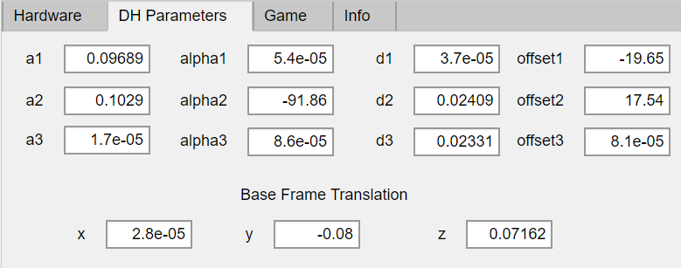
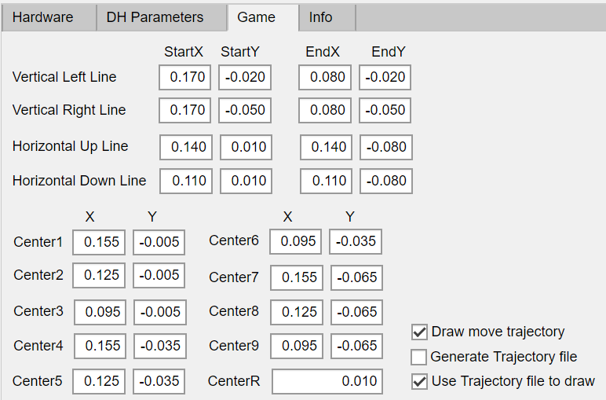
Configuration Dialog

Slide 15
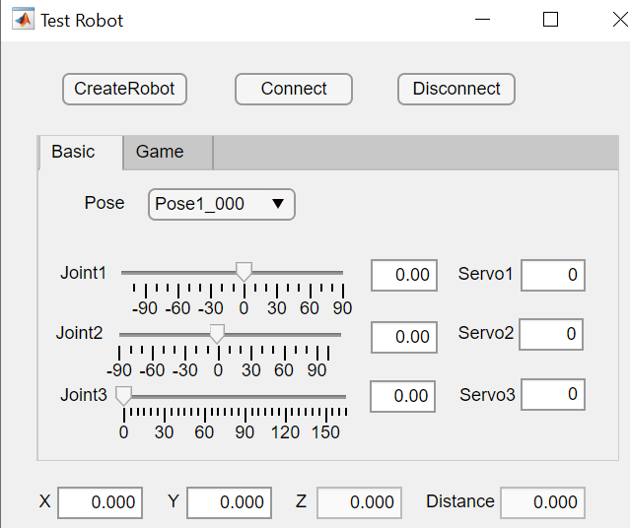
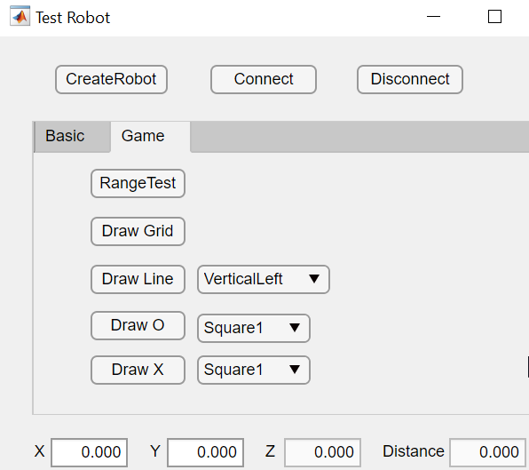
TestRobotDialog

Slide 16
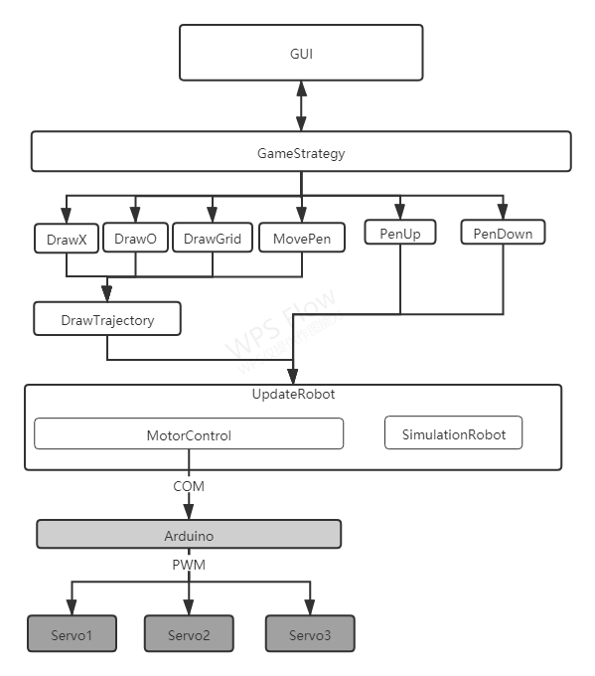

Slide 17
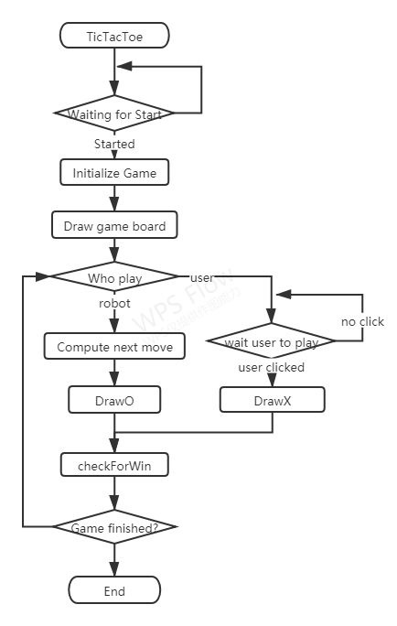
Main App Flowchart

Slide 18
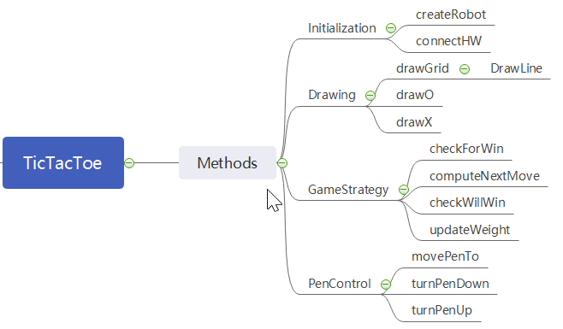
TicTacToae Class Methods

Slide 19
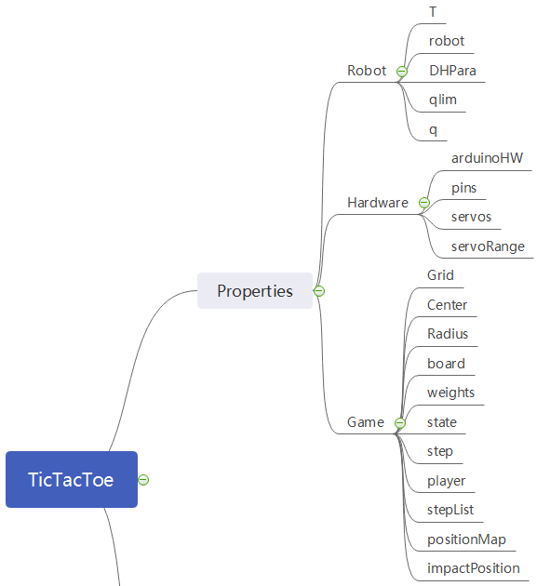
TicTacToae Class Properties

Slide 20
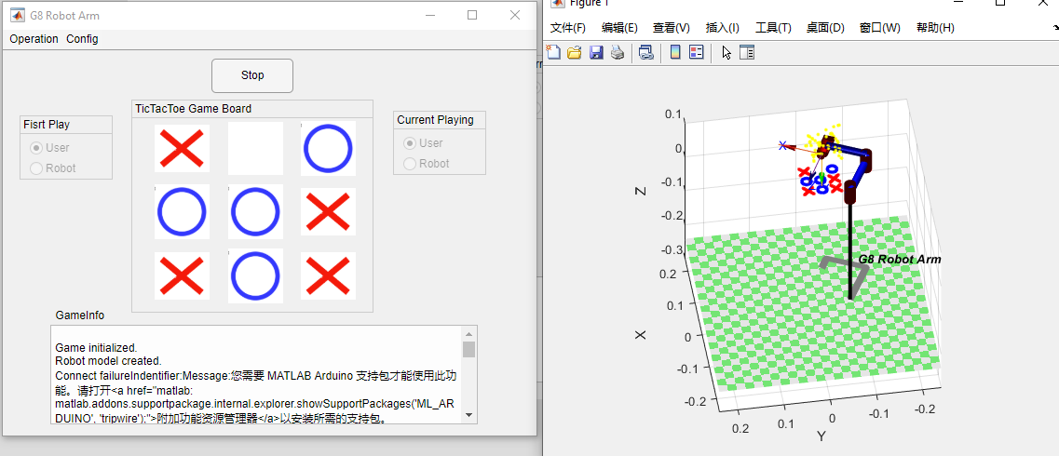
TicTacToe
The picture below shows a sample game. As we can see, the robot in the simulator can draw O and X with a designed strategy which will be explained in the later slides.

Slide 21

Robot not lose strategy
Basic logic:
1. Frist 4 steps are very important, corner is best, center is good, edge is last. we have very specific steps for first 4 steps.
2. From step4:
2.1 Select the position which robot could win within one step;
2.2 Select the position which user could win within one step;
2.3 Select the position which has highest weight for robot
2.4 Select the position which has highest weight for user
2. 5 Randomly choose highest weight for next positon
Game board position
Initial weight for both
1
4
7
3
2
3
2
5
8
2
4
2
3
6
9
3
2
3

Slide 22
Robot not lose strategy
Step1: User plays at position1
Game board position
X
4
7
2
5
8
3
6
9
Weight Change for user
Weight Change for robot
Change weight to 0 because it is not empty
0
2
3
0
1
2
Impacted position weight -1
2
4
2
1
3
2
3
2
3
2
2
2

Slide 23
Robot not lose strategy
Step2: Robot plays at position5
Game board position
X
4
7
2
O
8
3
6
9
Weight Change for user
Weight Change for robot
0
1
2
0
1
2
Impacted position weight -1 for opponent
Change weight to 0 because it is not empty
1
0
1
1
0
2
2
1
2
2
2
2

Slide 24
TicTacToe
5. Discussion
In this project, we learned how to connect the robot with Arduino board and how to control the servo motor via the Matlab/Arduino interface. And most importantly, we practice programming skill to implement several functionalities on this robot arm which include the TicTacToe game playing and decision-making policy. Finally, our robot arm can play TicTacToe game with a human player and never lose in the game.
Thanks to professor. Pandya!
If you have further question, please reach us out.

